Slide 1
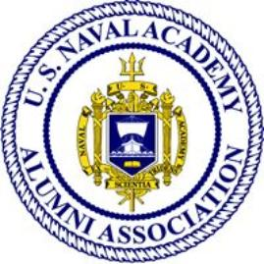
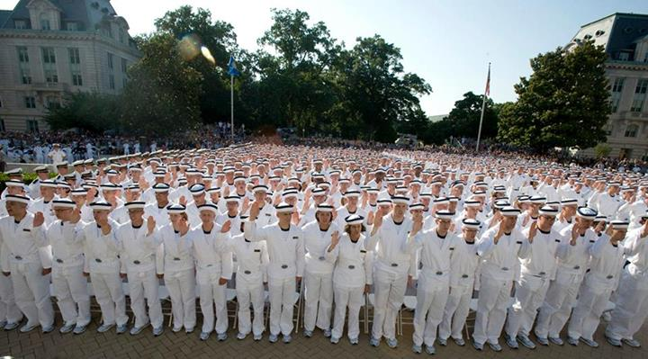
Quantico Area Chapter Vision, Mission, Objectives, and Goals
Vision
Maintain a robust, vital, healthy, active and engaged Chapter of the USNAAA.
Mission
Chapter Contacts:
President: Robin Dreeke, ’92
rdreeke@gmail.com
Vice President: George Williams, ’87 bucketokinawa@yahoo.com
Secretary: Nancy Springer ’87 nancy.a.springer.nancy@aol.com
Treasurer: Ron Diefenbach ’00
piranha25MM@hotmail.com
USNAAA Vision
We are the primary source for the community of Naval Academy alumni, family and friends, worldwide to maintain active lifetime links and be engaged with each other and the Naval Academy and its traditions.
Perpetuate the friendships and associations formed by Chapter members through their common experiences and interests in the Naval Academy and the Naval Services, to promote fraternity among Naval Academy alumni, to foster the interests of our country, the Naval Service, and the Naval Academy and to initiate and sponsor activities that will bond members of all classes and all generations in a common tradition of service, citizenship, fellowship and mutual support.
Goals
To encourage and facilitate friendships and associations, mentoring and advisory relationships, and to aid members.
To initiate and sponsor activities which will perpetuate the history, traditions, and memories of the Naval Academy, and bond alumni together in support of the highest ideals of command, citizenship, and government.
To seek out, inform, encourage, and assist outstanding, qualified young men and women to pursue careers as Officers in the Navy and Marine Corps, primarily, but not exclusively, commissioned through the Naval Academy.
To communicate the message of the Naval Academy to area Alumni, especially to our newest Alumni that are starting their careers or within their initial obligation.
Objectives
Develop an interesting and varied speaker schedule for monthly breakfast meetings.
Establish a membership committee and chair.
Partner with at least one other local community organization for the purpose of sponsoring a mutually beneficial activity.
Generate membership participation in planning and conducting activities.
Publish articles about our Chapter in Shipmate.
Continue to grow the Chapter membership across assigned geographic areas.
Hold a quarterly, evening social gathering in each distinct geographic area contained within Chapter coverage area.
Continue support for Quantico National Cemetery events.
Conduct an annual event that includes members and their families and prospective members.
Develop a service-oriented project that involves regular member participation.
Establish connections with other USNAAA Chapters and Parents Clubs in our geographic area.
Establish an outreach program for widows/ widowers of USNA grads.
Establish contact with and conduct one activity that includes Blue and Gold representative(s) and local Parents Chapters.
Establish an outreach program to parents of prospective Midshipmen.
Support STEM activities in the Chapter area.
Continue support for Quantico National Cemetery events.
Maintain a position on the Board of Trustees (BoT).
Establish and maintain formal contact with local USMC and USN support and command authorities.
Establish a procedure to refer graduating TBS/EWS/C&S students to the local alumni chapter at their next duty station.
Notes:
1

